Slide 1
Age Group and Gender Estimation
Presented by;
Yale Li
Zhong Zheng

Slide 2
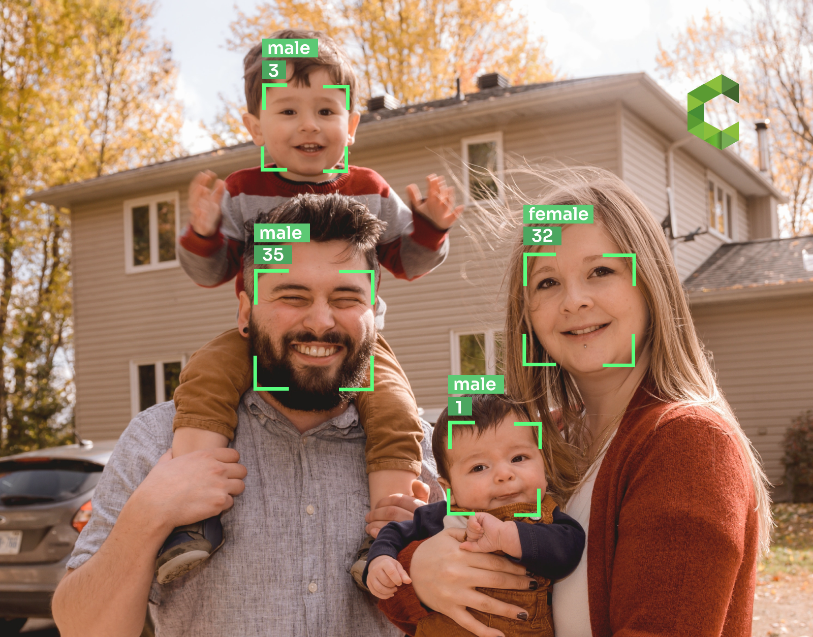
Why is it important?
Age and gender, two of the key facial attributes, play very fundamental roles in social interactions, making age and gender estimation from a single face image an important task in intelligent applications, such as access control, human-computer interaction, law enforcement, marketing intelligence, and visual surveillance, etc.
“Age & Gender Detection: Top Use Cases.” Cameralyze - No-Code Computer Vision Platform for Visual AI Applications, https://www.cameralyze.co/blog/age-gender-detection-top-use-cases. Accessed 14 Nov. 2022.

Slide 3
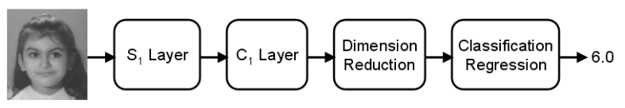
A Brief History
In the past twenty years, human age and gender estimation from face images have benefited tremendously from the evolutionary development in facial analysis. Early methods for age estimation were based on geometric features calculating ratios between different measurements.
biologically inspired features (BIF)
Guo, G., Guowang Mu, Fu, Y., & Huang, T. S. (2009). Human age estimation using bio-inspired features. 2009 IEEE Conference on Computer Vision and Pattern Recognition. https://doi.org/10.1109/cvpr.2009.5206681.

Slide 4
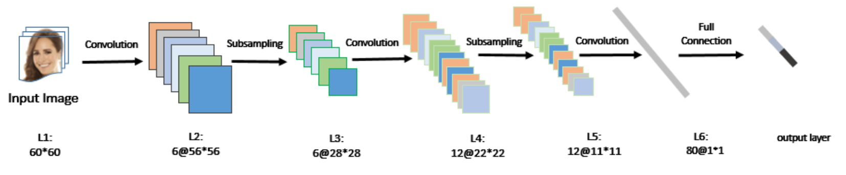
A Brief History
Recent researches on Convolutional Neural Networks (CNN) show that CNN model can learn a compact and discriminative feature representation when the size of training data is sufficiently large, so an increasing number of researchers start to use CNN for age and gender estimation.
X. Wang, R. Guo and C. Kambhamettu, "Deeply-Learned Feature for Age Estimation," 2015 IEEE Winter Conference on Applications of Computer Vision, 2015, pp. 534-541, doi: 10.1109/WACV.2015.77.

Slide 5
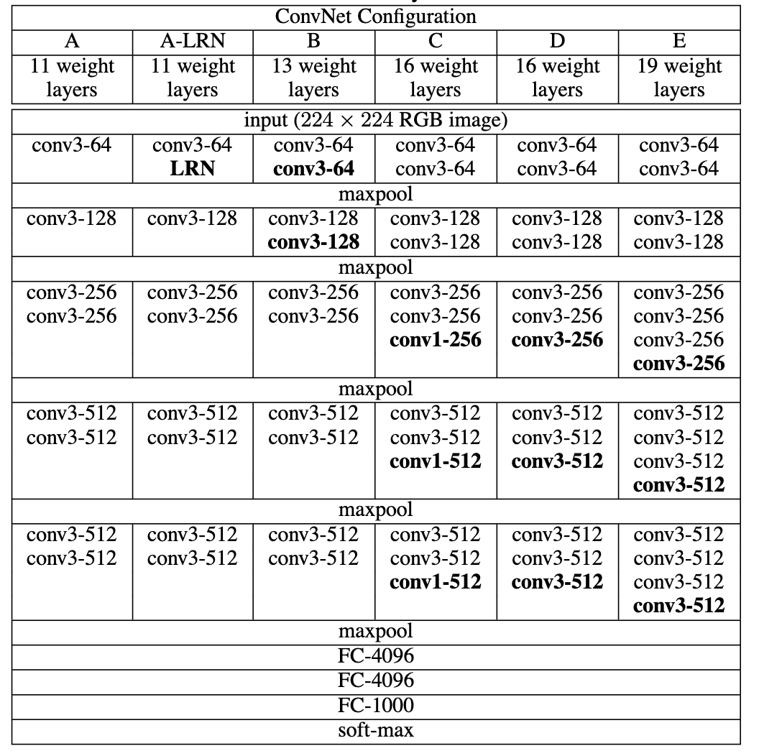
Other Architectures
VGG
It is widely acknowledged that the performance of CNN-based age and gender estimation relies heavily on the optimization ability of the CNN architecture, where deeper and deeper CNNs have been constructed.
Simonyan, Karen, and Andrew Zisserman. "Very deep convolutional networks for large-scale image recognition." arXiv preprint arXiv:1409.1556 (2014).

Slide 6
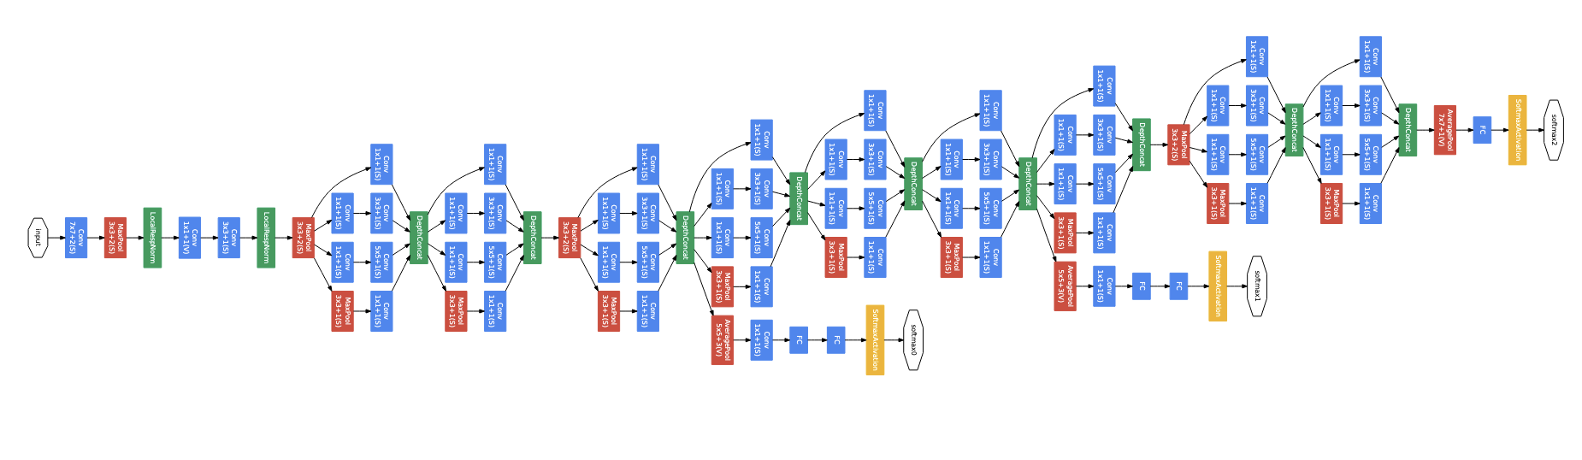
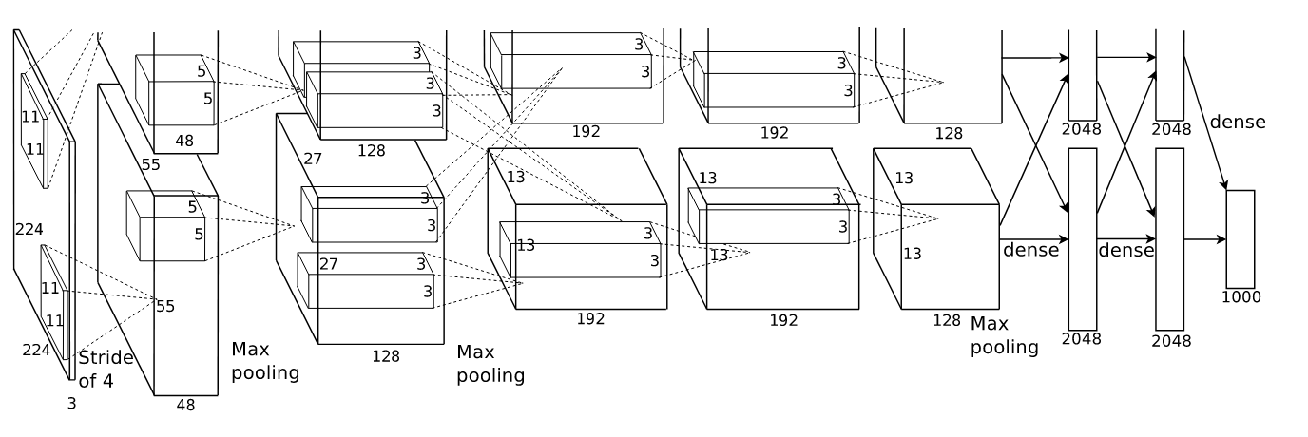
Other Architectures
AlexNet, GoogleNet
Krizhevsky, A., I. Sutskever, and G. Hinton. "Imagenet classification with deep convolutional networks." Proceedings of the Conference Neural Information Processing Systems (NIPS). Vol. 1097.
Szegedy, Christian, et al. "Going deeper with convolutions." Proceedings of the IEEE conference on computer vision and pattern recognition. 2015.

Slide 7
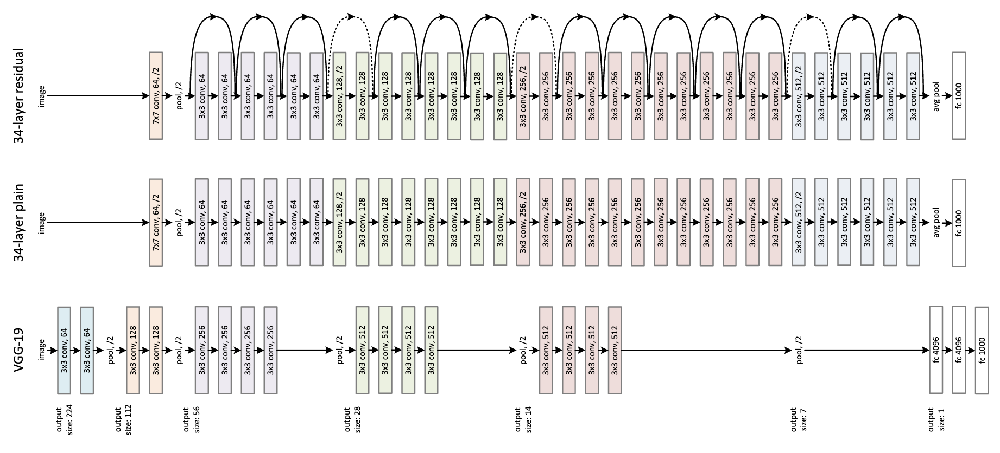
Other Architectures
ResNet
He, Kaiming, et al. "Deep residual learning for image recognition." Proceedings of the IEEE conference on computer vision and pattern recognition. 2016.

Slide 8
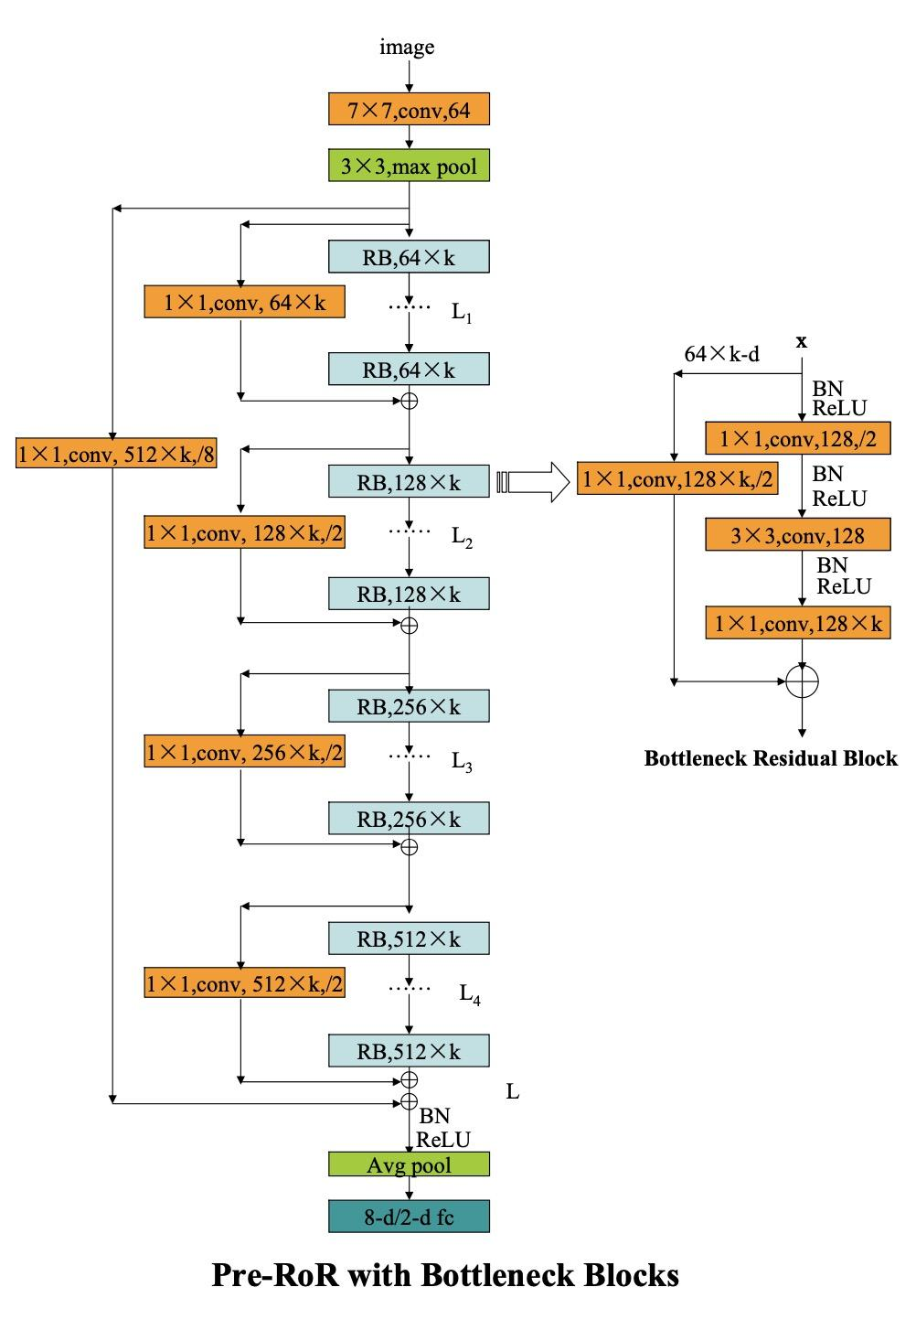
Residual Networks of Residual Networks (RoR)
Add shortcuts level by level based on residual networks, and achieved the state- of-the-art results
Zhang, Ke, et al. "Residual networks of residual networks: Multilevel residual networks." IEEE Transactions on Circuits and Systems for Video Technology 28.6 (2017): 1303-1314.

Slide 9
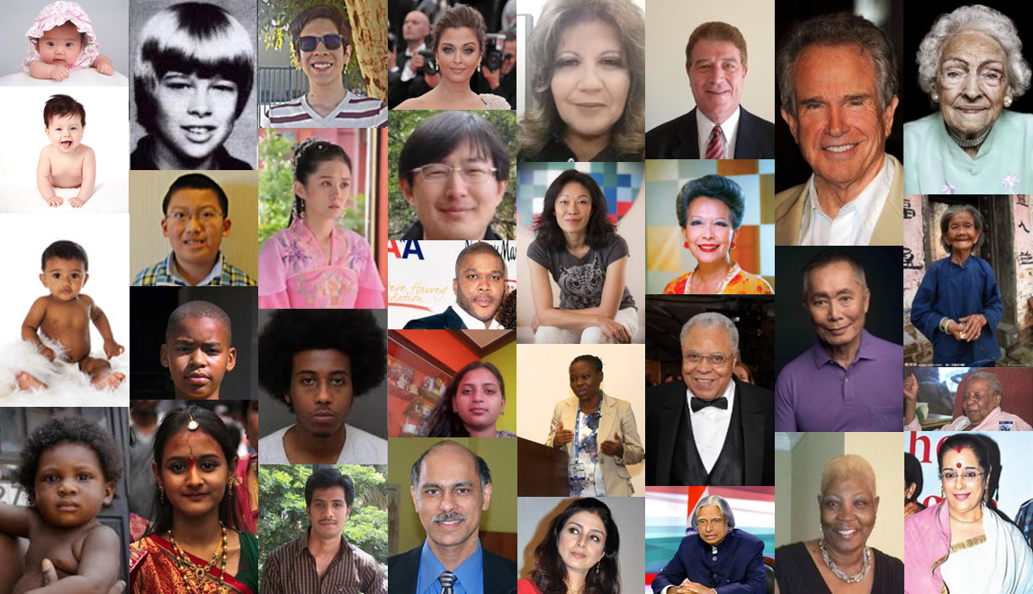
UTKFace
UTKFace dataset is a large-scale face dataset with long age span (range from 0 to 116 years old). The dataset consists of over 20,000 face images with annotations of age, gender, and ethnicity.
“UTKFace | Large Scale Face Dataset.” UTKFace, https://susanqq.github.io/UTKFace/. Accessed 28 Oct. 2022.

Slide 10
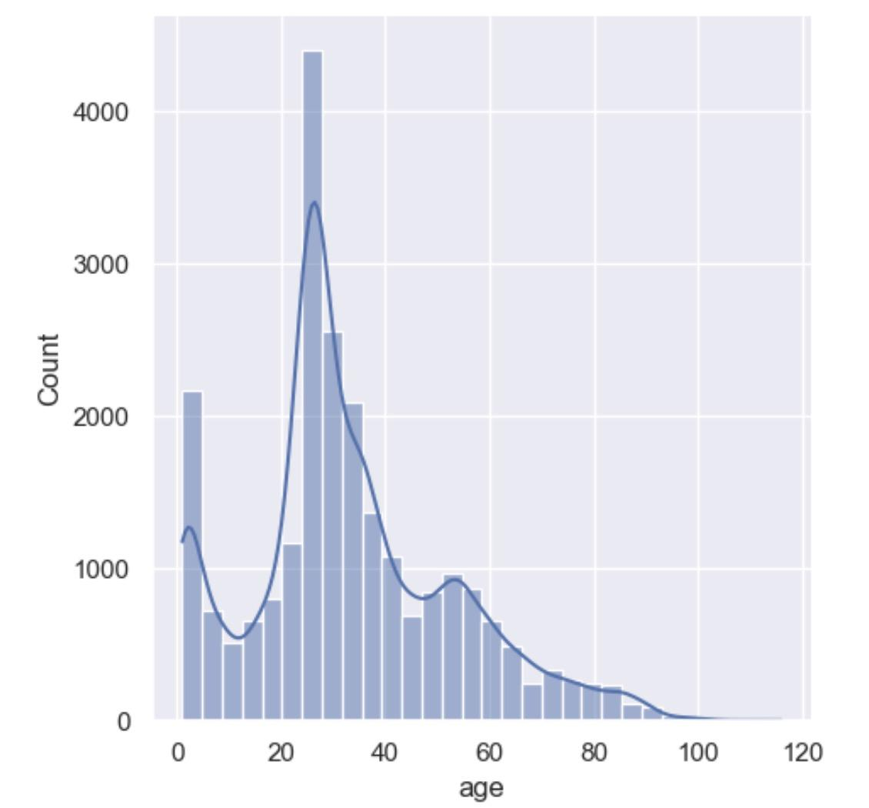
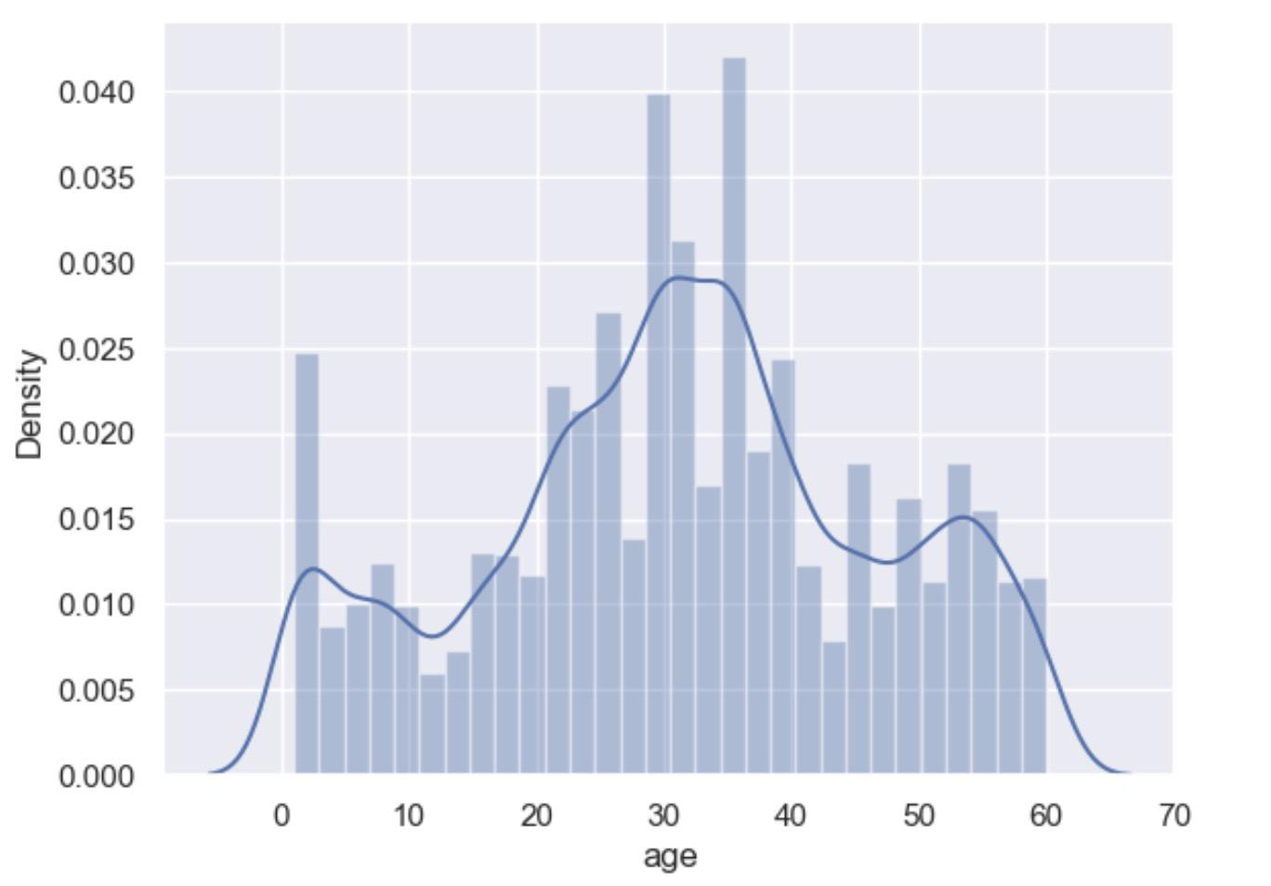
Data Pre-processing
Age distribution has a very high variance. That will cause the model to perform well at some particular age groups, in our case, the model might be over-performing in classifying the age group of 0-4 and 24-28.
Also, there is a few age data distributed over age 60.

Slide 11
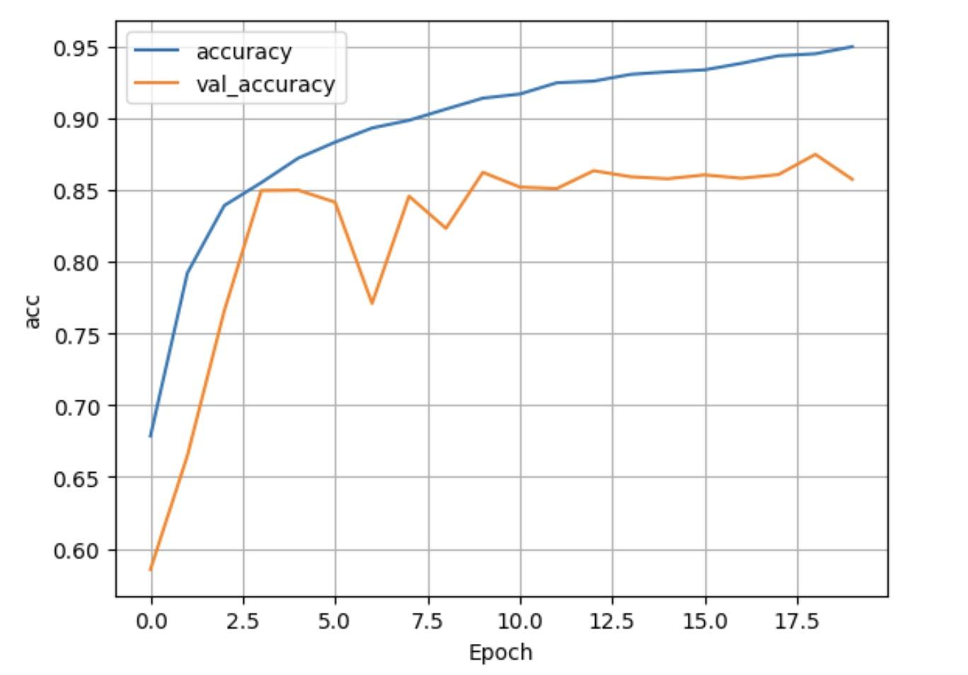
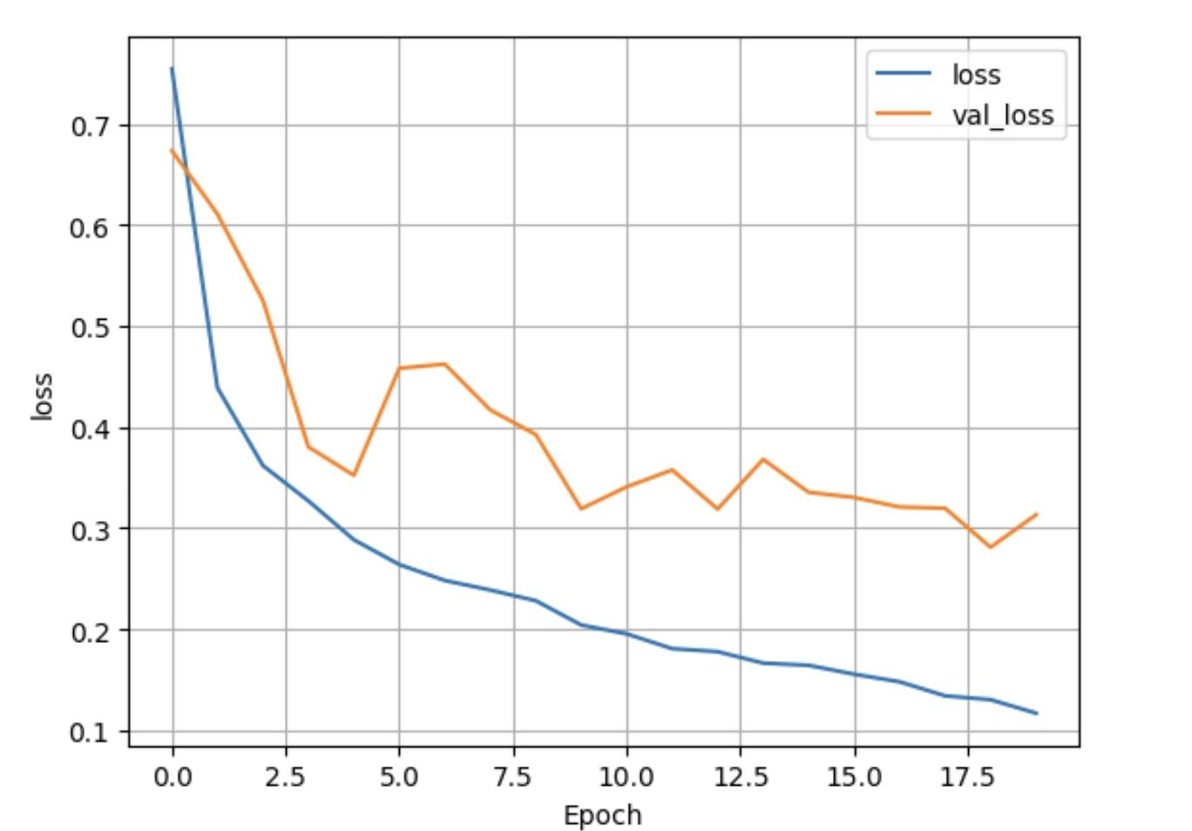
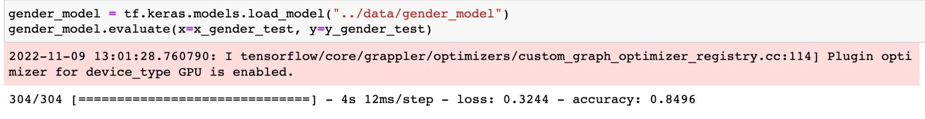
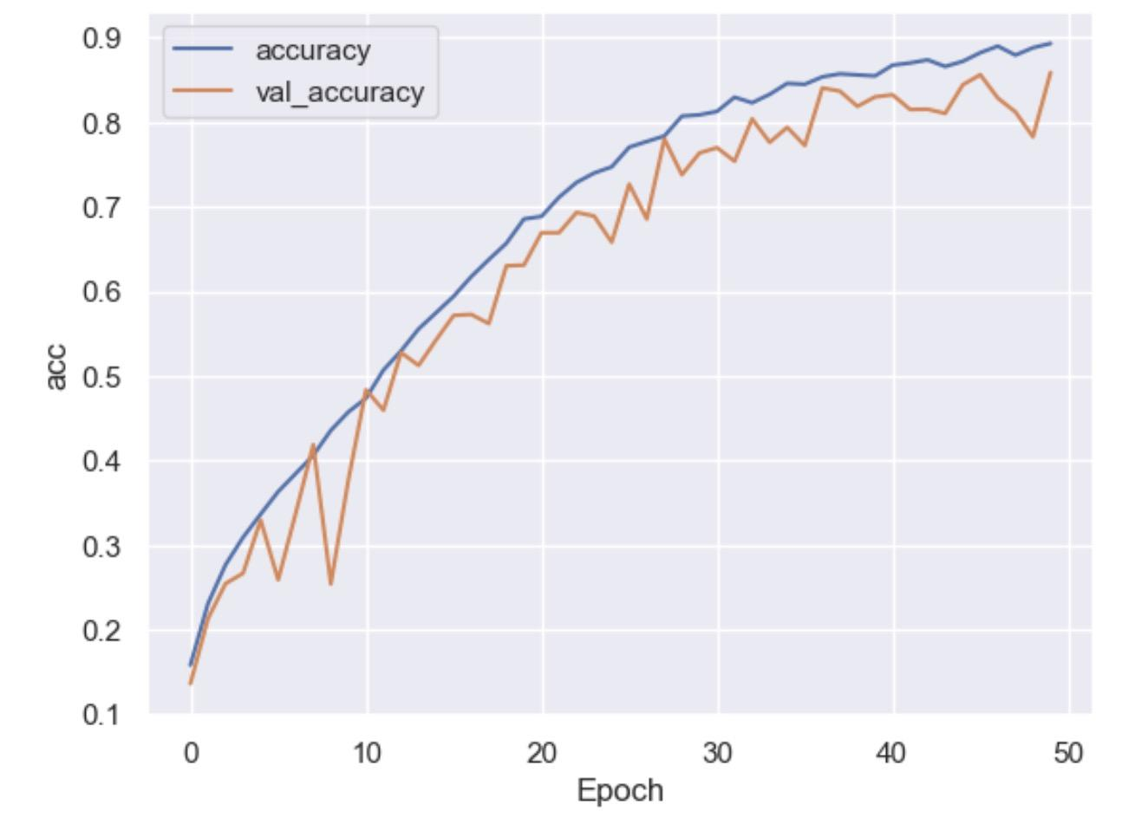
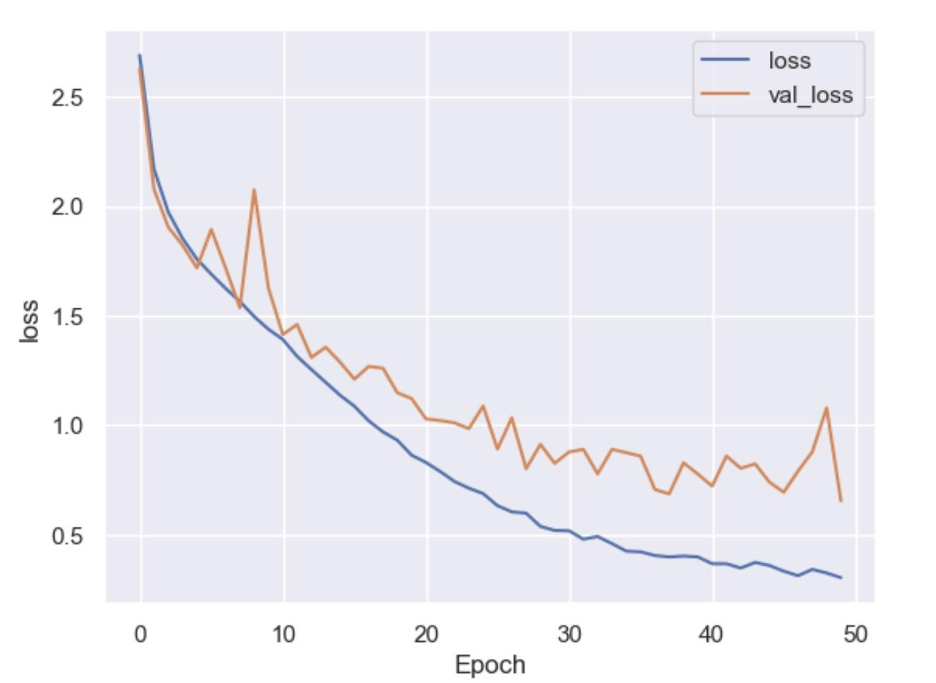
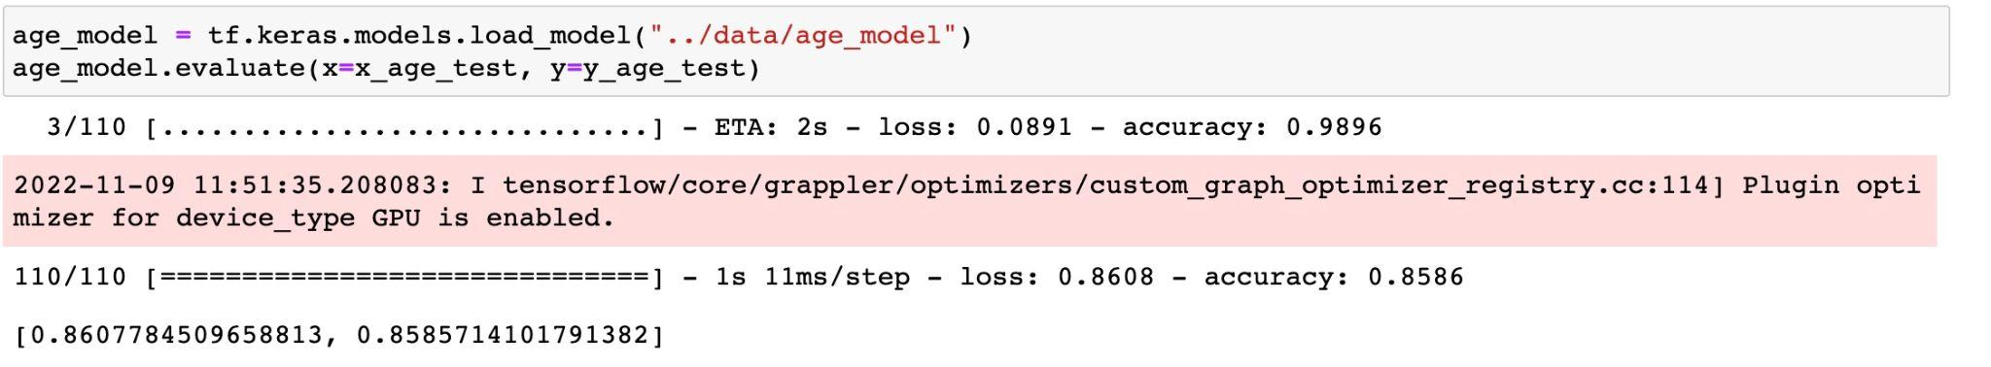
Results and discussion

Slide 12
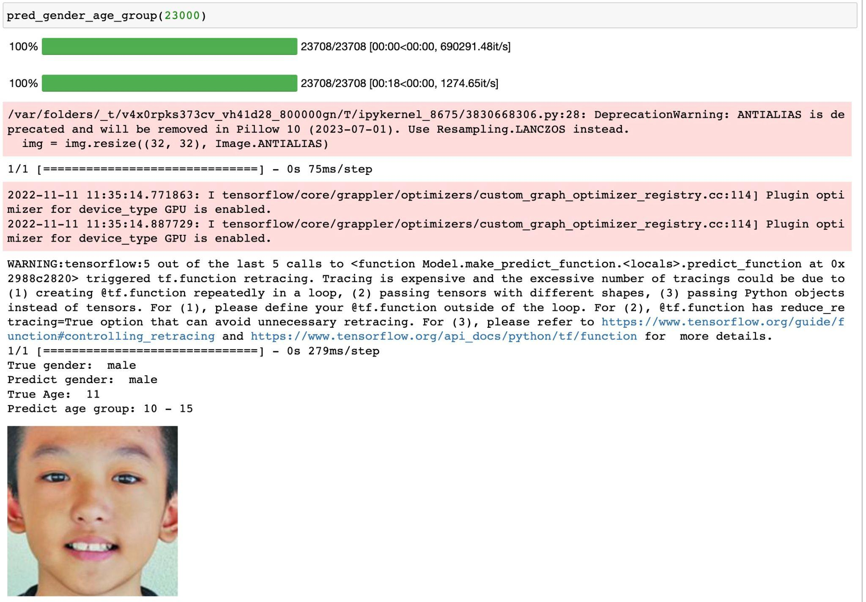
Use of Program

Slide 13
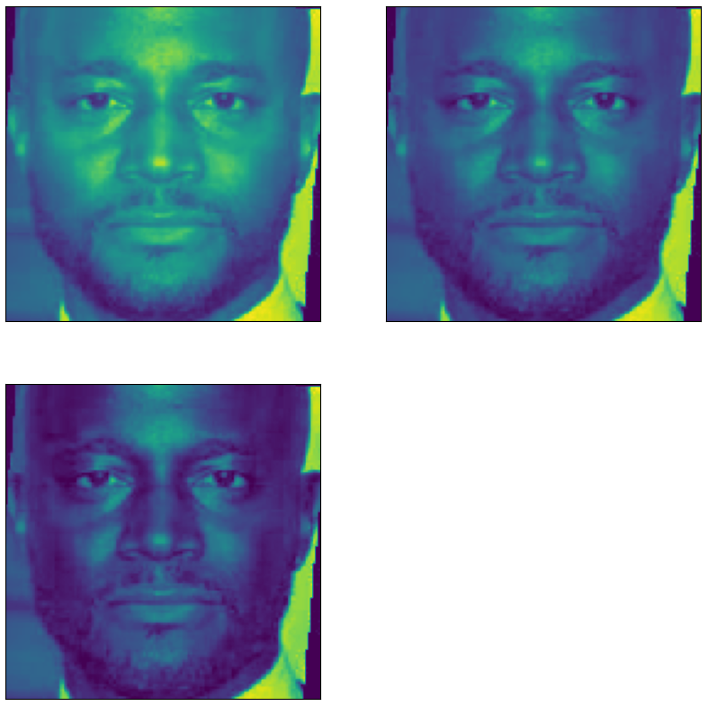
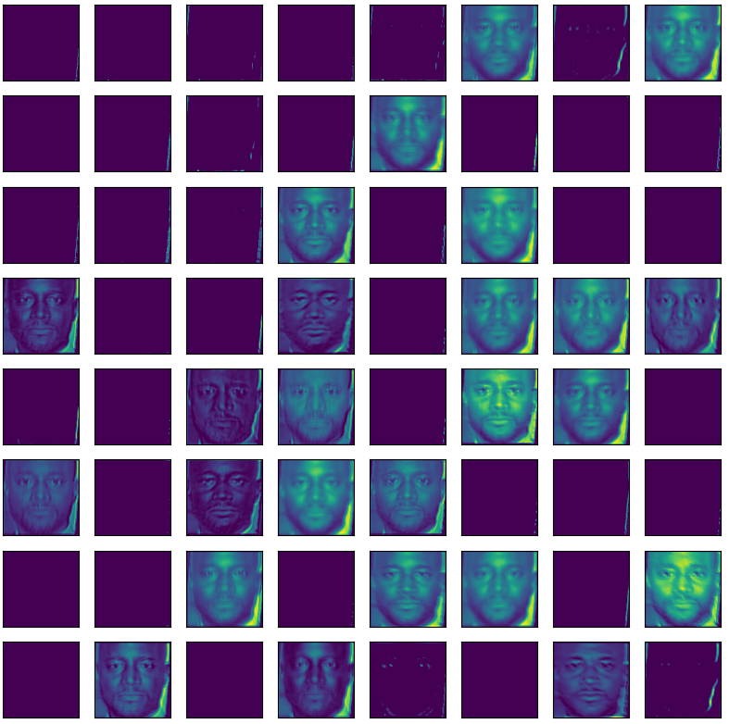
Visualization

Slide 14
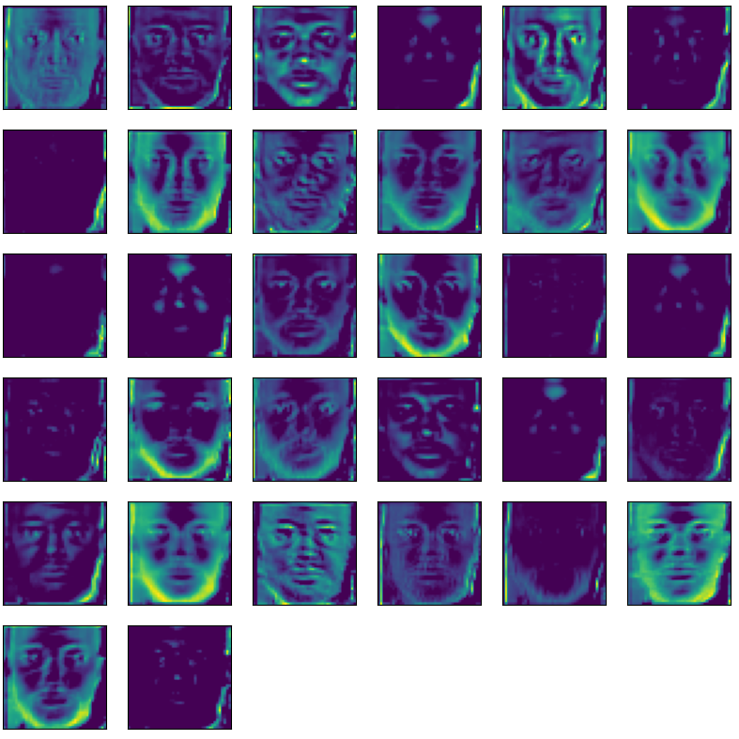
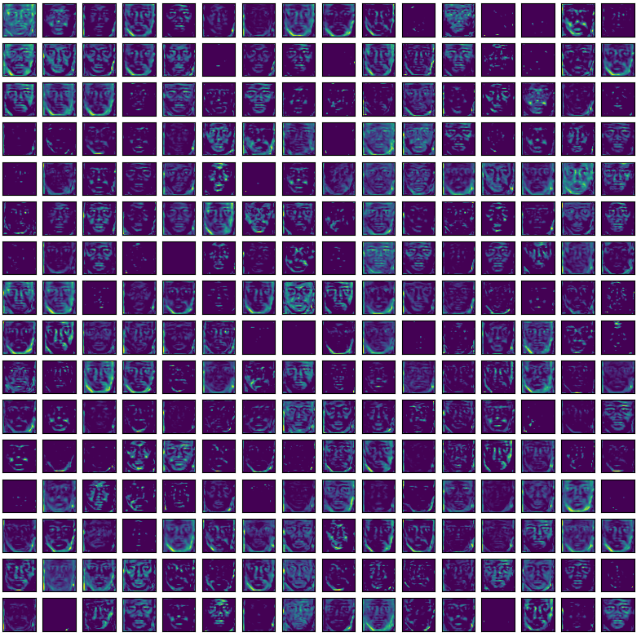
Visualization

Slide 15
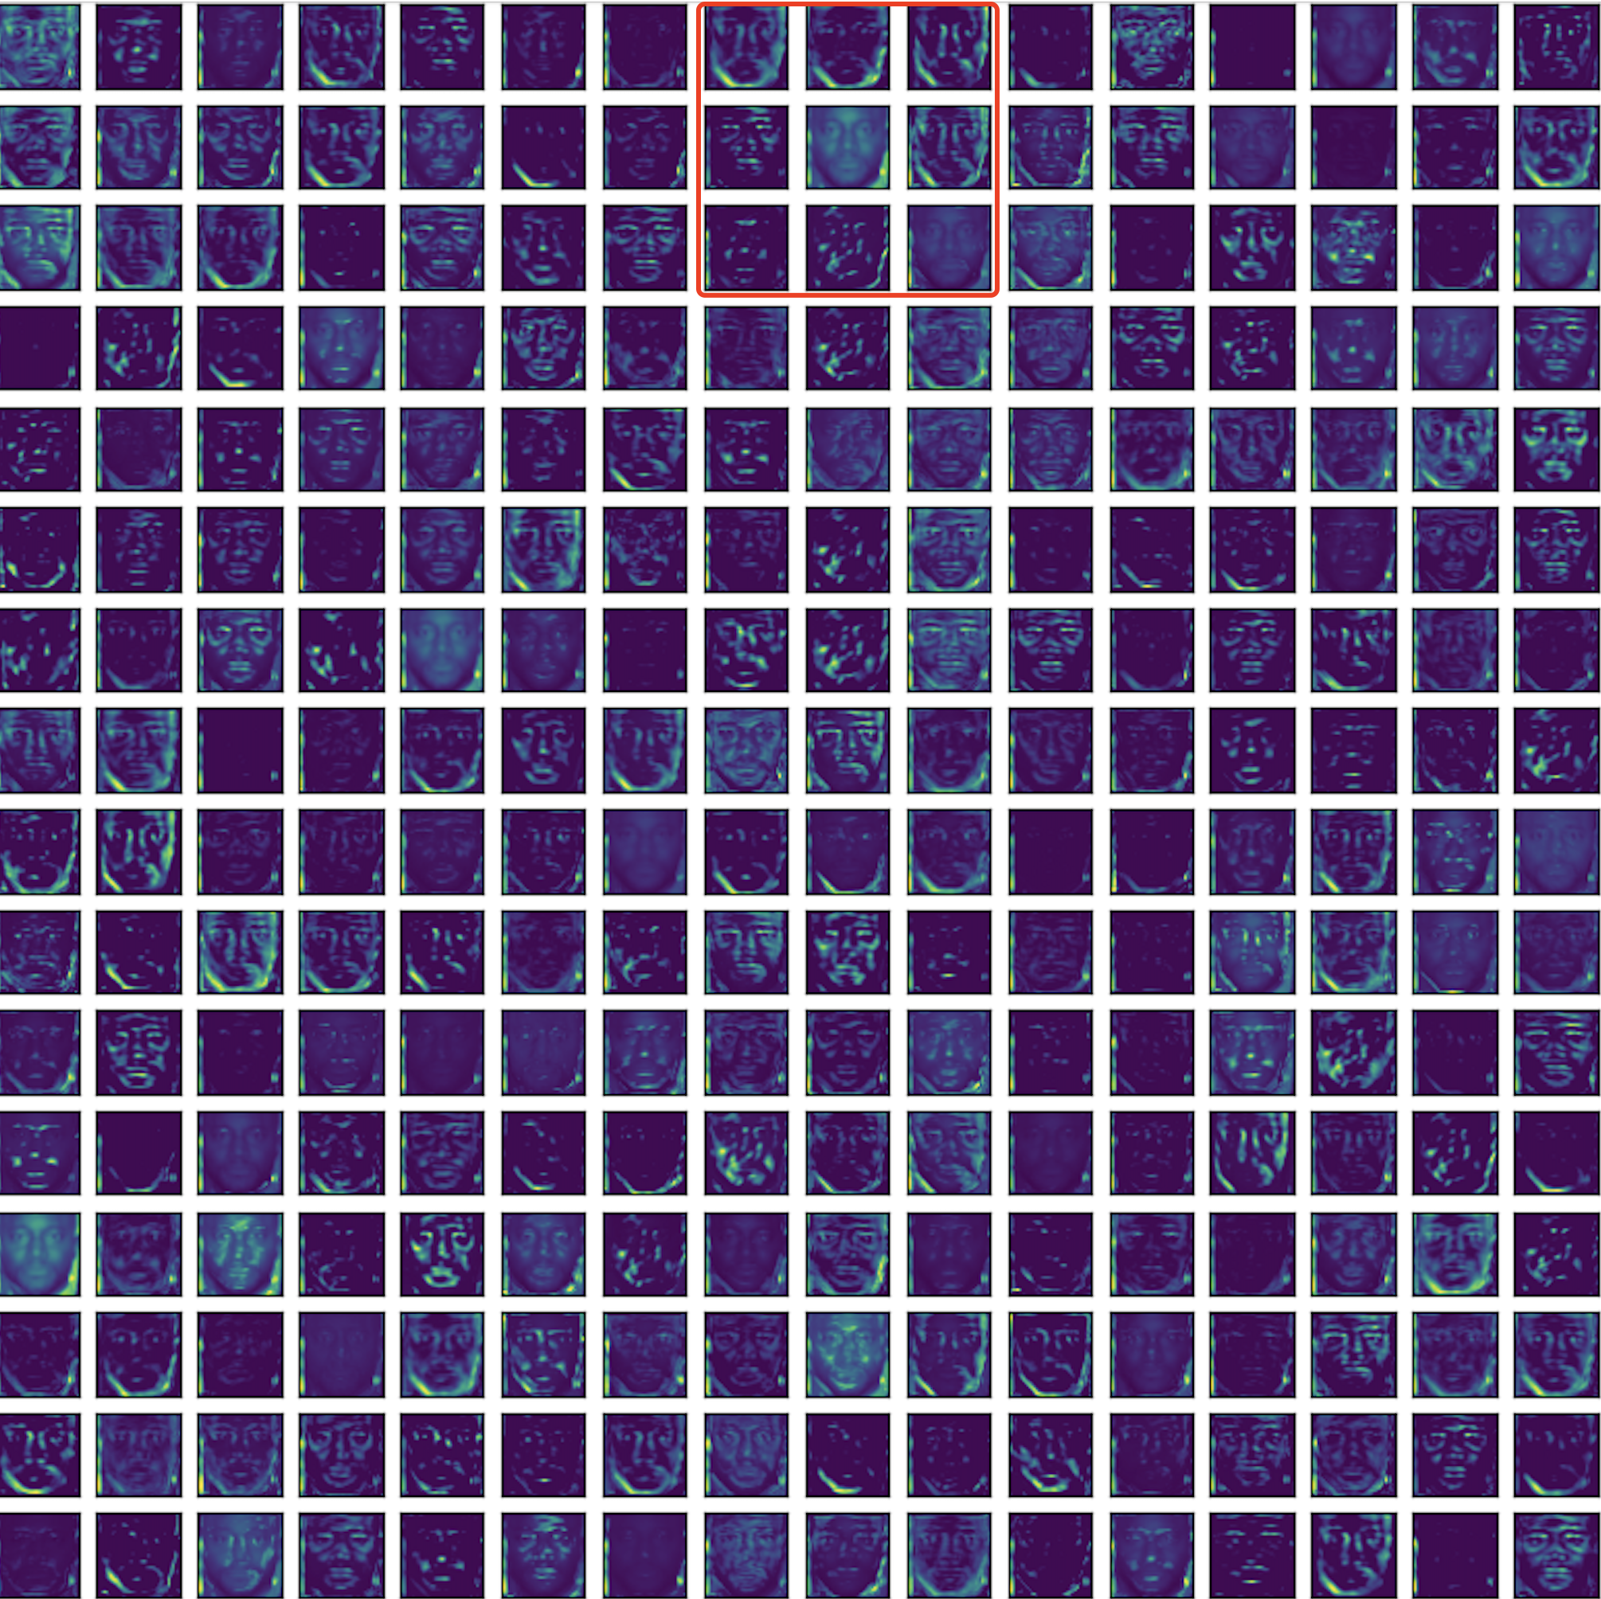
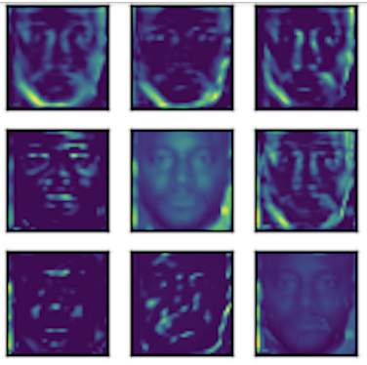
Visualization

Slide 16
Any Questions?

Slide 17
References
K. Zhang et al., "Age Group and Gender Estimation in the Wild With Deep RoR Architecture," in IEEE Access, vol. 5, pp. 22492-22503, 2017, doi: 10.1109/ACCESS.2017.2761849.
“UTKFace | Large Scale Face Dataset.” UTKFace, https://susanqq.github.io/UTKFace/. Accessed 28 Oct. 2022.
“Face Image Project.” Adience, https://talhassner.github.io/home/projects/Adience/Adience-main.html. Accessed 31 Oct. 2022.
Tal Hassner, Shai Harel*, Eran Paz* and Roee Enbar, Effective Face Frontalization in Unconstrained Images, IEEE Conf. on Computer Vision and Pattern Recognition (CVPR), Boston, June 2015.
Keras Team. “About Keras.” Keras: The Python Deep Learning API, https://keras.io/about/. Accessed 27 Oct. 2022.
eward96. “Age and Gender Prediction on UTKFace | Kaggle.” Kaggle: Your Machine Learning and Data Science Community, Kaggle, 14 Oct. 2022, https://www.kaggle.com/code/eward96/age-and-gender-prediction-on-utkface.
Razavian, A.S., Azizpour, H., Sullivan, J., & Carlsson, S. (2014). CNN Features Off-the-Shelf: An Astounding Baseline for Recognition. 2014 IEEE Conference on Computer Vision and Pattern Recognition Workshops, 512-519.
Kwon, Y. H., & Lobo, N. D. V. (1999). Age Classification from Facial Images. Computer Vision and Image Understanding, 74(1), 1–21. https://doi.org/10.1006/cviu.1997.0549.
Guo, G., Guowang Mu, Fu, Y., & Huang, T. S. (2009). Human age estimation using bio-inspired features. 2009 IEEE Conference on Computer Vision and Pattern Recognition. https://doi.org/10.1109/cvpr.2009.5206681.
Guodong Guo, Yun Fu, Dyer, C., & Huang, T. (2008). Image-Based Human Age Estimation by Manifold Learning and Locally Adjusted Robust Regression. IEEE Transactions on Image Processing, 17(7), 1178–1188. https://doi.org/10.1109/tip.2008.924280.
Zhang, Ke, et al. "Residual networks of residual networks: Multilevel residual networks." IEEE Transactions on Circuits and Systems for Video Technology 28.6 (2017): 1303-1314.

Slide 18
Thank You

